Slide 1


BREAST CANCER TUMOR
CLASSIFICATION
Team 7: Harry Cheung, Lauren Joo, Cecilia Park,
Arin Wang, Yuan Yuan

Slide 2





MEET THE TEAM
HARRY CHEUNG
LAUREN
JOO
CECILIA
PARK
ARIN
WANG
YUAN
YUAN

Slide 3
PRESENTATION AGENDA
PROJECT OVERVIEW
FAILED STEPS & COUNTERMEASURES
MODEL ANALYSIS
CONCLUSION

Slide 4

Breast Cancer is the second leading cancer in the United States
1 in 8 American women develop invasive breast cancer by 70
287,000 new cases of breast cancer predicted to be diagnosed
(30% of all cancer cases)
Detecting Breast Cancer at early stage gives survival rate of 93% and higher
More than 2.8 Million Breast Cancer Survivors in the US

Slide 5
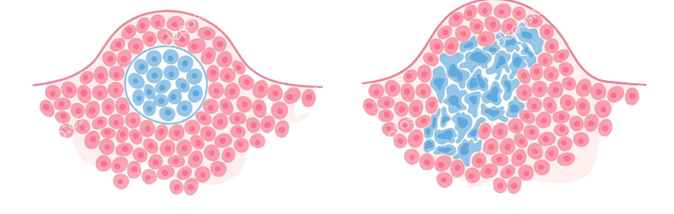
Project Overview
DATASET
Breast Cancer Patient Dataset → Tumor Classification as Malignant or Benign
RESEARCH TOPIC
Exploring the relationship between variables and tumor diagnosis
Benign
Malignant
PROJECT PURPOSE
Building and testing efficiency of different models for tumor classification
DATASET LINK: Click for access to dataset
Notes:
EEXPLAIN WHAT WE ARE DOING
DATA SET FROM KAGGLE
OUR GOAL WAS NOT TO CREATE A PERFECT MEDICAL MODEL BUT INSTEAD A TRIAL AND ERROR PROCESS TO DISCOVER WHICH MODEL METHOD FIT THE DATA THE BEST (ADV AND DIS) XPL

Slide 6
Dataset information
Y variable: Diagnosis (M=malignant, B = benign)
X variable:
Nucleus (Mean, SE, Worst);
Radius (Mean, SE, Worst);
Texture (Mean, SE, Worst);
Perimeter (Mean, SE, Worst);
Area (Mean, SE, Worst);
Smoothness (Mean, SE, Worst);
Compactness (Mean, SE, Worst);
Concavity (Mean, SE, Worst);
Concave Points (Mean, SE, Worst);
Symmetry (Mean, SE, Worst);
Fractal dimension (Mean, SE, Worst)
Dataset Link Here
Notes:
INSERT DATA SET INFORMATION IN HERE

Slide 7
FAILED APPROACHES & COUNTERMEASURES

Slide 8
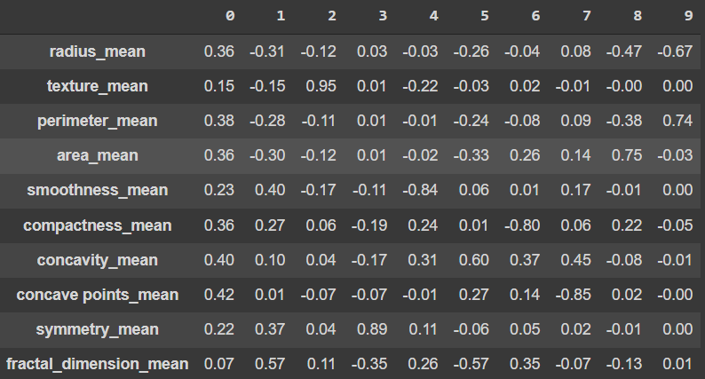
PCA aims to reduce data dimensions, but does not benefit our analysis
Reducing dimensions to unknown groups have no meaning to our project
Unable to interpret principal components because variables have no correlation between each other
Unable to show which variables are important
Component Relationships with Mean Tumor Variables
PCA will only decrease our accuracy rate
Notes:
** Commas and periods are places where you pause/hold when you speak.
PCA aims to reduce data dimensions, but does not benefit our analysis. The first component is comprised of random-like ranges of numbers between 0-1. This is also apparent throughout the other columns. This means there is no correlation between the variables and we are unable to interpret what the principal components represent.
Since we are unable to show which variables are more important, we fail to achieve our goal here. If PCA is used, it will only decrease our accuracy rate, so we look to other models like the logistic regression.

Slide 9
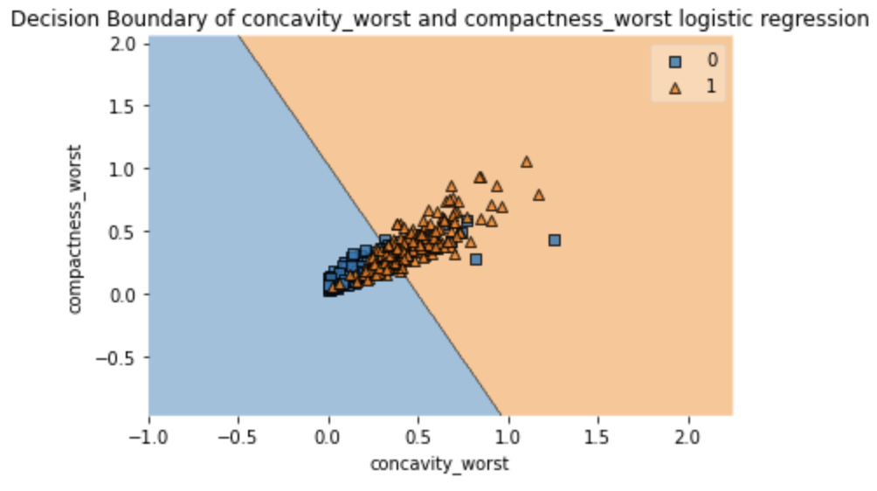
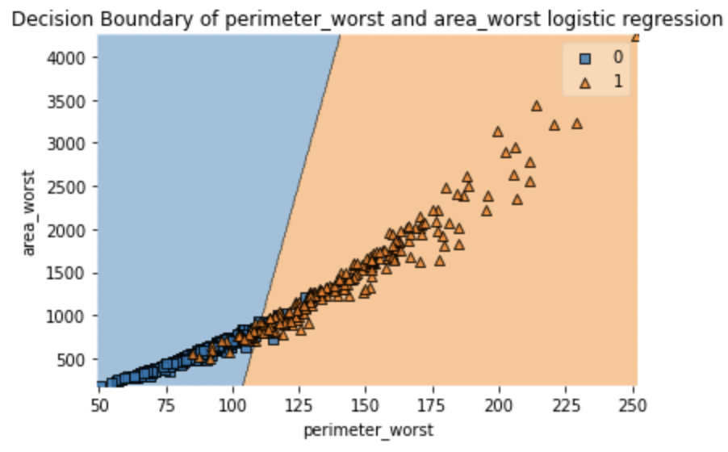
Logistic Regression fails to capture complicated relationships for our datasets
1.
2.
3.
Chose the cut-off point with the best accuracy score
(cut off value → 0.4)
The decision region for both largest and smallest coefficient features cannot separate data efficiently
(accuracy rate = about 50%)
Non-linear Model: support vector machine with polynomial kernel still can’t separate data efficiently
Notes:
** Commas and periods are places where you pause/hold when you speak.
Amidst our optimistic exploration into logistic regressions, it failed to capture complicated relationships for our datasets because of the low of accuracy. Although we try to increase accuracy by using different cutoff points, the accuracy remains low. This low accuracy score is evident when we plot the largest and smallest coefficient features. Notice that both the graphs are unable to separate tumor records into benign or malignant accurately. These graphs share an accuracy rate of about 50%.

Slide 10
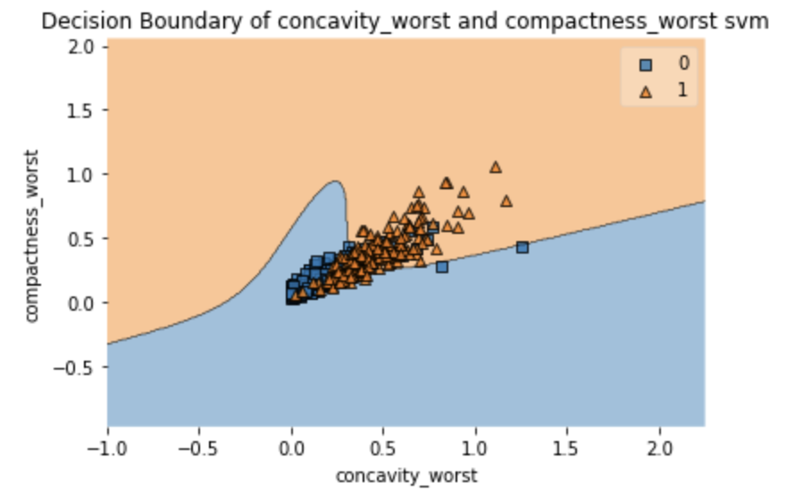
Logistic Regression fails to capture complicated relationships for our datasets
1.
2.
3.
Chose the cut-off point with the best accuracy score
(cut off value → 0.4)
The decision boundary for both largest and smallest coefficient features cannot separate data efficiently
Non-linear Model: support vector machine with polynomial kernel still can’t separate data efficiently
Notes:
** Commas and periods are places where you pause/hold when you speak.
After our failure with linear models, we look to non-linear models. However, after fitting our data with a support vector machine with a polynomial kernel, our records are still unable to separate accurately evidenced with the right hand graph.
Lauren will now talk about the more successful measures we took after finding inconclusive results from PCA and logistic regressions.

Slide 11

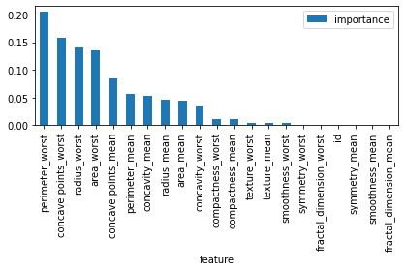
Amidst failed attempts, we took different approaches and examined other models as countermeasures
3 SEPARATE DATASETS
RANDOM FOREST IMPORTANCE FEATURES
Mean
Mean & Worst
Worst
average tumor records
combination
severe tumor records
Mimic PCA properties and divide data in the best way
Examine models 3 separate ways to further analyze our data

Slide 12
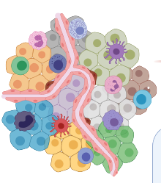
Amidst failed attempts, we took different approaches and examined other models as countermeasures
Perimeter total distance from one end points to another
RANDOM FOREST IMPORTANCE FEATURES
Concavity severity of concave portions of the contour
Concave Points number of concave portions of the contour
Breast Cancer Tumor
Size & Shape important features in our dataset
These explanatory variables also used in decision trees

Slide 13
SUCCESSFUL MODEL ANALYSIS

Slide 14
k-Nearest Neighbors

Slide 15
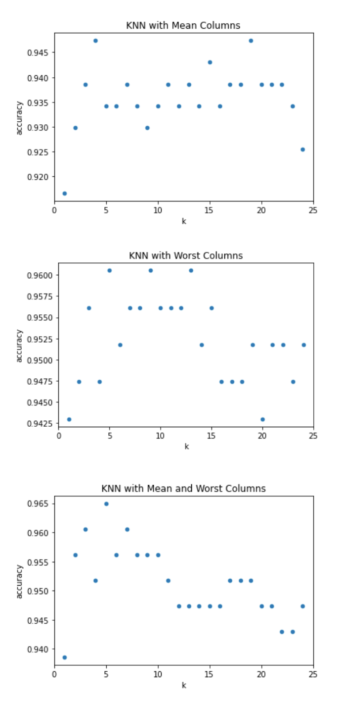
Uniform weights k-NN algorithm yielded promising prediction accuracy in testing set
1.
2.
3.
Chose uniform weights due to lack of knowledge of how each feature should weigh
Through 25 iterations in a for loop, we chose a k-value of 5
k-NN performed the best when both Mean and Worst columns are included
Final results indicated a 96.5% accuracy in
predicting malignancy in testing set, a 92.9% TPR, and a 7.1% FNR
Notes:
Chose uniform weights where each variable is weighted equally, due to lack of knowledge of how each feature should weigh
I deleted this part for space - maybe u can memorize just this part
Lauren

Slide 16
Neural
Networks

Slide 17

We try various layers and nodes to find the optimal weight that yields the best prediction
A Layer with
2 Nodes
A Layer with
5 Nodes
3 Layers with
2 Nodes
3 SEPARATE DATASETS
Mean
Mean & Worst
Worst
Notes:
** Commas and periods are places where you pause/hold when you speak.
After running k-nn, we explored more models like Neural networks because they have great predictive ability and can capture complicated, ‘non-linear’ relationships between variables.
Similar to the other models, we explored 3 different neural network models on each three dataset. We ran a total of 9 neural networks to find the optimal weight that yields the best prediction.

Slide 18


We try different Activation Methods to reduce the error between output y and target variables
X VARIABLES
ACTIVATION FUNCTIONS
Y OUTPUT
1.
2.
3.
Turned categorical variable ‘diagnosis’ to dummy values
Scale variables to 0-1, using min-max normalization function
Train the model
With the Logistic Model, the diagnosis comes out as numerical values
By using Numpy, we transfer back to binary values
Logistic
Identity/Linear
Tanh
Relu
Notes:
https://www.v7labs.com/blog/neural-networks-activation-functions
** Commas and periods are places where you pause/hold when you speak.
In order to run the neural network, we need to preprocess the x variables and put them through different activation functions in order to get a y output.
The first step for us is to pre-process the X variable. In this step, we turn categorical variables to dummy values and normalize variables to 0 and 1, using the minimum-maximum normalization function. After that, we split the data to train, validate, and test the model.
Then we ran those inputs into the 4 different activation functions: logistic, linear, tanh, and relu under sklearn’s neural network package called the MLPRegressor. Under these conditions, we found that the logistic model works best with our predictions.
However, we found that with the logistic model, the diagnosis comes out as numerical values. Therefore, in order to solve this problem, we transferred the numerical values to binary values through the Numpy package. We took about 3 hours finding the solution to this problem.

Slide 19
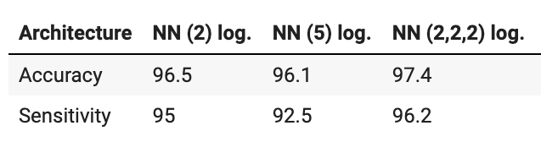
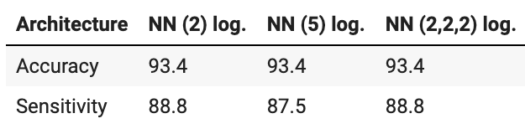
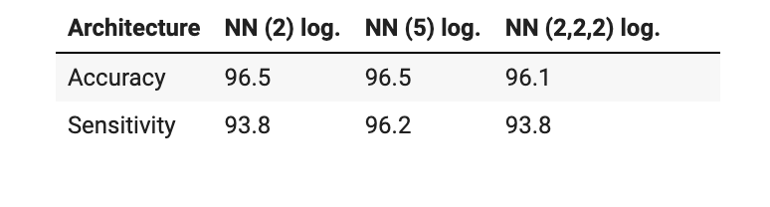
Neural networks have the highest accuracy and sensitivity rate, but relationships between predictors and outcomes remain unanswered
WORST COLUMNS
MEAN COLUMNS
MEAN & WORST
In general, neural networks predict precise result with the data, with all accuracies above 93%:
However, neural networks is a ‘black box’ prediction machine, with no insight into relationships between predictors and outcomes
By training the columns with ‘worst’ tumor records, we obtain the highest accuracy and sensitivity rate
Notes:
The neuron network shows great performance on predicting the outcome. And it has the highest accuracy rate and sensitivity rate compared with other models, meaning the neuron network has the strongest ability to find all the positive samples and predict the correct results. However, there are still some drawbacks of this model. Firstly, the hidden layers blur the relationship between predictors and outcome, making it hard to identify the key variables that determine the cancer.
** Commas and periods are places where you pause/hold when you speak.
After running the model, neural networks turned out to be a great metric for predicting tumor diagnosis. In fact, it has the highest accuracy and sensitivity rate compared to other models. However, there are still some drawbacks to this model. The relationship between predictors and outcomes remain unanswered, making it hard to identify key variables that determine breast cancer classification.
Lauren will explain our decision tree findings that do identify those key variables.

Slide 20
Decision
Trees

Slide 21
Throughout all datatypes, the tumor’s perimeter, concave points, and concavity were parameters chosen under each reduced tree
PERIMETER
CONCAVE POINTS
CONCAVITY
Larger perimeter leads to a higher probabilistic chance of a tumor being classified malignant
More concave points lead to a higher chance of a tumor being classified malignant
Greater concavity leads to higher chances of a tumor being malignant

Slide 22
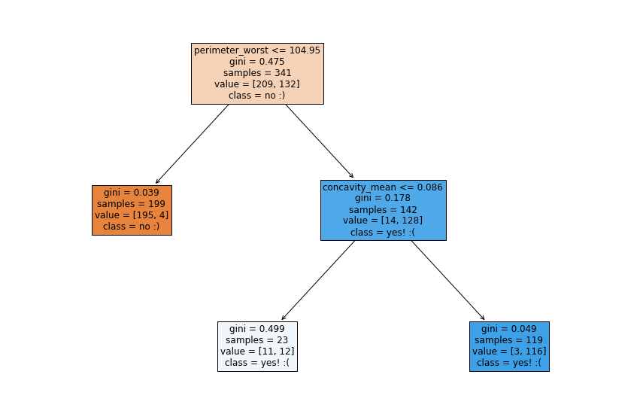
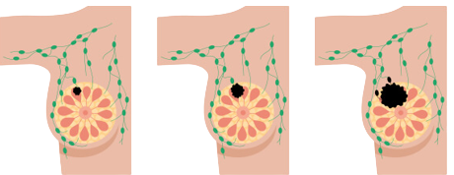
Throughout all datatypes, the tumor’s perimeter, concave points, and concavity are parameters chosen under each reduced tree
PERIMETER
Larger perimeters lead to a higher probabilistic chance of a tumor being classified malignant
Perimeters past a certain threshold classify as malignant
The rightmost black tumor has the highest chance of classifying malignant

Slide 23
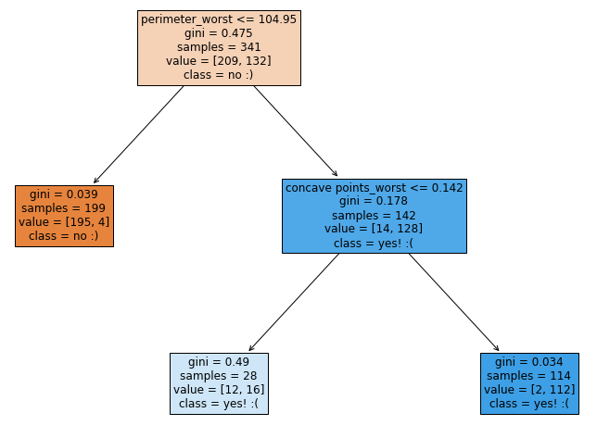
Throughout all datatypes, the tumor’s perimeter, concave points, and concavity are parameters chosen under each reduced tree
PERIMETER
CONCAVE POINTS
Larger perimeters lead to a higher probabilistic chance of a tumor being classified malignant
More concave points lead to a higher chance of a tumor being classified malignant
Concave points past a threshold classify as malignant
Although, concave points below that threshold were still classified malignant, there is greater uncertainty

Slide 24
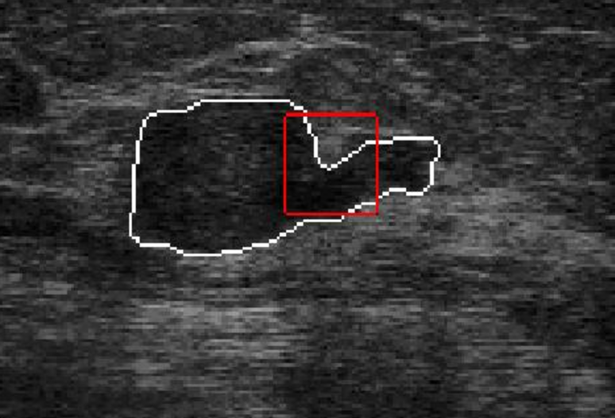
Throughout all datatypes, the tumor’s perimeter, concave points, and concavity are parameters chosen under each reduced tree
CONCAVITY
Greater concavity leads to higher chances of a tumor being malignant
Concavity greater than a threshold are highly likely to classify as malignant
Although, concavity below that threshold were still classified malignant, there is less certainty, leaving such records inconclusive

Slide 25
Best Model: Neural Network
Model Performance Comparison
 | RESULTS
Model | Accuracy | Sensitivity/ TPR | FNR | Can Identify Key Variables
KNN | 96.5% | 92.9% | 7.1% | X
Neural Network | 97.4% | 96.2% | 3.8% | X
Decision Tree | 86.4% | 86.3% | 13.7% | O
Notes:
NN 3 layers with 2 nodes
Possibly due to NN works better with smaller dataset

Slide 26
Inevitably, our models encountered limitations during the course of data exploration
Unknown New
Patient Data
Small
Dataset Size
Models Lack Explanation
Dataset contains 500 entries, lowering precision and increasing risk
Unable to test our models with new patient records without medical examination
Most sensitive models do not explain depth and detail of variables

Slide 27
We can further implement our data and models by…
Collaborate with Hospitals
Exploring Different Models
Hands on work with doctors to develop our models and predict classification on real patient data
Further data exploration with other models that have explanatory features similar to decision trees

Slide 28
THANK YOU
WE WILL NOW OPEN THE FLOOR TO QUESTIONS

